Slide 1

Delivery and Tracking application
A report Submitted
For partial completion of the degree of
Bachelor of Engineering
By
Md Hammad Rasheed (211220200016)
Md Amash Shams(211220200001)
Under the supervision of
Mr. Md Zeeshan Rasheed, Last Year Btech Student, Dept. of IT
(Duration : 4th May, 2023 to 3rd June, 2023)
IMARAT INSTITUTE OF COMPUTER & ELECTRONICS,
PHUWARISHARIFF, PATNA, BIHAR, INDIA 2023
1

Slide 2
ACKNOWLEDGEMENT
We take this opportunity to thank all the people who have rendered their full support to our project work. We render our thanks to our mam and sir, Professor of our college who encouraged us to do the Project. We are grateful to Perveen Agarwal, CCO Textbook for facilitating all the amenities required for carrying out this project. We express our sincere gratitude to skill academy textbook faculties, Dean Academics for providing an excellent environment in the college. We are also thankful to Tamosa Mam, Ahana Guchait Mam and Pijus Bairi Sir, faculties of the Department for providing us with both time and amenities to make this project a success within the given schedule. We are also thankful to our guide Uttam Grade sir Skill Academy Placement Trainer, for hir valuable guidance and encouragement given to us throughout the project work. We would like to thank the entire IT Department faculty and Skill Academy faculties, who helped us directly and indirectly in the completion of the project. We sincerely thank our friends and family for their constant motivation during the project work.
2

Slide 3
ABSTRACT
In this fast-moving generation, the present study proposes the newer concept of predicting the prices of certain items. With an idea and motivation to help everyone we came up with a solution to get an appropriate estimate of one’s car using Machine Learning Techniques which will save a lot of time and money. A car price prediction has been a high interest research area, as it requires noticeable effort and knowledge of the field expert. Considerable number of distinct attributes is examined for the reliable and accurate prediction. The production of cars has been steadily increasing in the past decade, with over 70 million passenger cars being produced in the year 2016. This has given rise to the used car market, which on its own has become a booming industry. The recent advent of online portals has facilitated the need for both the customer and the seller to be better informed about the trends and patterns that determine the value of a used car in the market. To build a model for predicting the price of used cars in, we applied one of the machine learning techniques i.e., Linear Regression. Using linear regression, there are multiple independent variables, but one and only one dependent variable whose actual and predicted values are compared to find precision of results. Our paper proposes a system where price is dependent variable which is predicted, and this price is derived from factors like kilometers driven, car purchase year, Car Company, car model, and the fuel type.
Keywords:
Car Price Predictor, Machine Learning, Python, Linear Regression, Dependent variable, NumPy, Pandas etc.
3

Slide 4
INDEX
S No. | CONTENTS | PAGE No.
1. | Introduction ……………………………………………………………… | 5
2. | Software requirements ………..……………………………………. | 6
3. | Technology …………………………..……………………….……………. | 7
 | 3.1 Python …..………………………………………………………………. | 7
 | 3.2 Machine Learning……………………………………..……………. | 7
 | 3.3 Streamlit ………………………………………………………………… | 7
 | 3.4 Python Libraries……………………………………………………… | 7
 | 3.5 SQL Database …………….………………………………………….. | 7
4. | Coding ……………………………………………………….………………… | 8-18
5. | Screenshots ……………….………………………………………………… | 19
6. | Learning Objective ………………………………………………………… | 20
7. | EDA and Data Pre-Processing ………………………………………. | 21-23
7. | Methodology ……………..………………………………………………… | 23-29
8. | Results ………….…………………………………………….………………… | 30
9. | Contributions | 31
10. | References …………………………………………………………………… | 32
4

Slide 5
Introduction
One of the main areas of research in machine learning is the prediction of the price of cars. It is based on finance and the marketing domain. It is a major research topic in machine learning because the price of a car depends on many factors. Some of the factors that contribute a lot to the price of a car are:
Brand
Model
Year of Purchase
Driver
Owner Type
Engine
Transmission etc.
If one ignores the brand of the car, a car manufacturer primarily fixes the price of a car based on the features it can offer a customer. Later, the brand may raise the price depending on its goodwill, but the most important factors are what features a car gives you to add value to your life. So, in the section below, I will walk you through the task of training a car price prediction model with machine learning using the Python programming language.
5

Slide 6
Software Requirements
Software: (Anaconda/VS code)
Visual Studio Code is a streamlined code editor with support for development operations like debugging, task running, and version control. It aims to provide just the tools a developer needs for a quick code-build-debug cycle and leaves more complex workflows to fuller featured IDEs, such as Visual Studio IDE.
Web Brouwer:
(Google Chrome/ Mozilla Firefox/ Safari Web Browser / Microsoft Edge)
A web browser takes you anywhere on the internet. It retrieves information from other parts of the web and displays it on your desktop or mobile device. The information is transferred using the Hypertext Transfer Protocol, which defines how text, images and video are transmitted on the web.
GitHub:
GitHub is a code hosting platform for version control and collaboration. It lets you and others work together on projects from anywhere. This tutorial teaches you GitHub essentials like repositories, branches, commits, and pull requests.
6

Slide 7
Technologies Required
NumPy:
NumPy is a Python library used for working with arrays. It also has functions for working in domain of linear algebra, fourier transform, and matrices. NumPy was created in 2005 by Travis Oliphant.
Pandas:
Pandas is a Python library used for working with data sets. It has functions for analyzing, cleaning, exploring, and manipulating data. The name "Pandas" has a reference to both "Panel Data", and "Python Data Analysis" and was created by Wes McKinney in 2008.
Matplotlib:
Matplotlib is a comprehensive library for creating static, animated, and interactive visualizations in Python. Matplotlib makes easy things easy and hard things possible. Create publication quality plots.
Seaborn:
Seaborn is a library for making statistical graphics in Python. It builds on top of matplotlib and integrates closely with pandas data structures. Seaborn helps you explore and understand your data.
Scikit-Learn:
Scikit-Learn, also known as sklearn is a python library to implement machine learning models and statistical modelling. Through scikit-learn, we can implement various machine learning models for regression, classification, clustering, and statistical tools for analyzing these models.
StreamLit:
Streamlit is an open-source Python library that makes it easy to create and share beautiful, custom web apps for machine learning and data science. In just a few minutes you can build and deploy powerful data apps.
7

Slide 8
Source Code
Importing necessary libraries.
import numpy as np
import pandas as pd
import matplotlib.pyplot as plt
import seaborn as sns
import warnings
warnings.simplefilter("ignore")
Importing the csv dataframe and Analysing the dataframe
dataframe = pd.read_csv("CAR DETAILS.csv")
dataframe.head()
Analysing the datatypes of columns of the dataframe
dataframe.dtypes
Storing a copy of a dataframe
df= dataframe.copy()
Analysing the copied dataset
df.head()
EDA (Exploratory Data Analysis)
Analysing the info of dataframe
dataframe.info
Analysing the description of dataframe
dataframe.describe
Analysing null values of dataframe
dataframe.isnull().sum()
Analysing duplicated values of dataframe
dataframe.duplicated().sum()
8

Slide 9
Source Code
Droping the duplicated values of dataframe. And analysing the dataframe
dataframe.drop_duplicates(inplace = True)
dataframe.duplicated().sum()
Analysing the columns of dataframe
columns=dataframe.columns
Columns
Analysing the unique values of the brand column of dataframe
dataframe['Brand'].unique()
Analysing the unique value of all the columns of dataframe
for column in columns:
if column == "selling_price" or column == "km_driven":
pass
else:
print(f"{column} \n {dataframe[column].unique()}")
print("-------------------------------------------------------------------------------------------------------")
Data Pre-Processing
from sklearn.preprocessing import LabelEncoder
Create an instance of the OneHotEncoder
label_encoder = LabelEncoder()
def label_encode(column):
# Fit and transform the column
dataframe[column] = label_encoder.fit_transform(dataframe[column])
# Print the encoded DataFrame
print(dataframe.head())
9

Slide 10
Source Code
Applying label encoder on all the required columns
label_encode("Brand")
label_encode("fuel")
label_encode("seller_type")
label_encode("transmission")
label_encode("owner")
Analysing theKm_driven column of dataframe.
dataframe["km_driven"]
Plotting the box plot for Km_driven column of dataframe.
# Plotting box plot
plt.figure(figsize=(4,4)) # Set the figure size
plt.boxplot(dataframe["km_driven"])
# Adding title and labels
plt.title('Box Plot of km_driven')
plt.xlabel('km_driven')
plt.ylabel('Distance in Kilometers')
# Display the plot
plt.show()
10

Slide 11
Source Code
Building user defined function for removing Outliers from a column and dataframe
def Outlier_free(col):
Q3=np.quantile(dataframe[col],0.75)
Q1=np.quantile(dataframe[col],0.25)
IQR = Q3 - Q1
lower_limit = Q1 - 1.5*IQR
upper_limit = Q3 + 1.5*IQR
suri = dataframe[((dataframe[col] >= lower_limit) & (dataframe[col] <=upper_limit ))]
dataframe[col] = np.where(dataframe[col] >= upper_limit,
upper_limit,
np.where(dataframe[col] <= lower_limit,
lower_limit,
dataframe[col]))
plt.figure(figsize=(4,4))
plt.boxplot(dataframe[col])
plt.xlabel(f"{col}")
plt.title(f"Outlier_free_{col}")
plt.show()
Removing outliers from Km_driven columns and Plotting box plot
Outlier_free("km_driven")
Splitting data into Dependent y and Independent X variables
X= dataframe.drop(['selling_price','name'], axis=1)
y= dataframe.selling_price
print(X.shape)
print(y.shape)
Analysing the independent variable columns
X.columns
11

Slide 12
Source Code
Plotting and Analyzing correlation table
corr= X.corr()
plt.figure(figsize=(7,7))
sns.heatmap(corr, annot=True, cmap='coolwarm')
plt.show()
Filtering the correlation table
Identify columns to drop
columns_to_drop = corr.columns[((corr.abs() > 0.75) & (corr.abs() > -0.75)).any()]
columns_to_drop
Building a user defined function to filter
def correlation(dataset, threshold1, threshold2):
corr_= set()
corr = dataset.corr()
for i in range(len(corr.columns)):
for j in range(i):
if abs(((corr.iloc[i, j]) > threshold1) | ((corr.iloc[i, j]) < threshold2)):
colname_i = corr.columns[i]
corr_.add(colname_i)
return corr_
correlation(X, 0.75, -0.75)
X.Shape
cr = X.corr()
plt.figure(figsize=(7,7))
sns.heatmap(cr, annot=True, cmap='coolwarm')
plt.show()
12

Slide 13
Source Code
Scaling the X variables and building Standard Scaler model
from sklearn.preprocessing import StandardScaler
scale = StandardScaler()
Fitting and transforming the data for scaling
X_scaled = scale.fit_transform(X)
X_scaled
Spliting data into train and test data
from sklearn.model_selection import train_test_split
x_train,x_test,y_train,y_test=train_test_split(X_scaled,y,test_size=.20,random_state=4)
Building a user defined function for evaluationg the model test, train accuracy score
def evaluate_score(model):
from sklearn.metrics import r2_score, mean_absolute_error, mean_squared_error
import math
model.fit(x_train,y_train)
y_pred=model.predict(x_test)
print(f"*---------------------------------------Score_{model}-------------------------------------*")
rr= r2_score(y_test, y_pred)
print(f"The R2_Score is :- {rr} \n")
# Evaluate the model on the training data
train_score = model.score(x_train, y_train)
# Evaluate the model on the test data
test_score = model.score(x_test, y_test)
# Print the training and test scores
print(f"Training Score: {train_score} \n")
print(f"Test Score: {test_score} \n " )
13

Slide 14
Source Code
Applying various Machine Learning model
Building and fitting Linear Regression ML model
from sklearn.linear_model import LinearRegression
lr = LinearRegression()
Analysing the evaluated score
evaluate_score(lr)
Building and fitting Random Forest Regressor ML model
from sklearn.ensemble import RandomForestRegressor
rfc= RandomForestRegressor(n_estimators=300,criterion='poisson', max_depth= 10, max_samples=0.8)
Analysing the evaluated score
evaluate_score(rfc)
Building and fitting Bagging Regression ML model
from sklearn.ensemble import BaggingRegressor
bg = BaggingRegressor(n_estimators=500, verbose= 1)
Analysing the evaluated score
evaluate_score(bg)
14

Slide 15
Source Code
Building and fitting Extra Tree Regressor ML model
from sklearn.ensemble import ExtraTreesRegressor
etr=ExtraTreesRegressor(n_estimators=5000, max_depth=5, criterion="absolute_error")
Analysing the evaluated score
evaluate_score(etr)
Building and fitting Polynomial RegressionML model
from sklearn.preprocessing import PolynomialFeatures
# Create polynomial features
poly_features = PolynomialFeatures(degree=6)
X_poly = poly_features.fit_transform(x_train)
# Perform linear regression
regressor = LinearRegression()
regressor.fit(X_poly, y_train)
from sklearn.base import RegressorMixin
X_poly_test = poly_features.transform(x_test)
# Evaluate the model on the training data
train_score = regressor.score(X_poly, y_train)
# Evaluate the model on the test data
test_score = regressor.score(X_poly_test, y_test)
15

Slide 16
Source Code
Analysing the evaluated score
print(f"Training Score: {train_score} \n")
print(f"Test Score: {test_score} \n " )
Building and fitting Ada Boost Regression ML model
from sklearn.ensemble import AdaBoostRegressor
abr = AdaBoostRegressor(n_estimators=10000, learning_rate=1.15)
Analysing the evaluated score
evaluate_score(abr)
Building and fitting Support Vector Regression ML model
from sklearn.svm import SVR
svr = SVR(kernel='rbf',
degree=3,
gamma='scale',
coef0=0.0,
tol=0.001,
C=1.0,
epsilon=0.1,
shrinking=True,
cache_size=200,
verbose=False,
max_iter=-1,)
16

Slide 17
Source Code
Analysing the evaluated score
evaluate_score(svr)
Building and fitting Gradient Boosting Regression ML model
from sklearn.ensemble import GradientBoostingRegressor
gbr = GradientBoostingRegressor(n_estimators=800, learning_rate=0.2, random_state=45,max_features='auto’)
Analysing the evaluated score
evaluate_score(gbr)
Building and fitting Hist Gradient Boosting Regression ML model
from sklearn.ensemble import HistGradientBoostingRegressor
hbr = HistGradientBoostingRegressor(l2_regularization=0.8)
Analysing the evaluated score
evaluate_score(hbr)
17

Slide 18
Source Code
Saving the best suitable model
We will continue with Random Forest regression ML Model. And saving that model
import pickle
model = rfc
with open('final_model.pkl', 'wb') as f:
pickle.dump(model, f)
Loading that Ml Model
# Assuming your pickle file is named 'model.pkl'
with open('final_model.pkl', 'rb') as f:
model = pickle.load(f)
Creating 20 random point table for the further test
data = dataframe.sample(20)
Data
Saving the random point in pkl format
model1 = data
with open('data.pkl', 'wb') as f:
pickle.dump(model1, f)
18

Slide 19
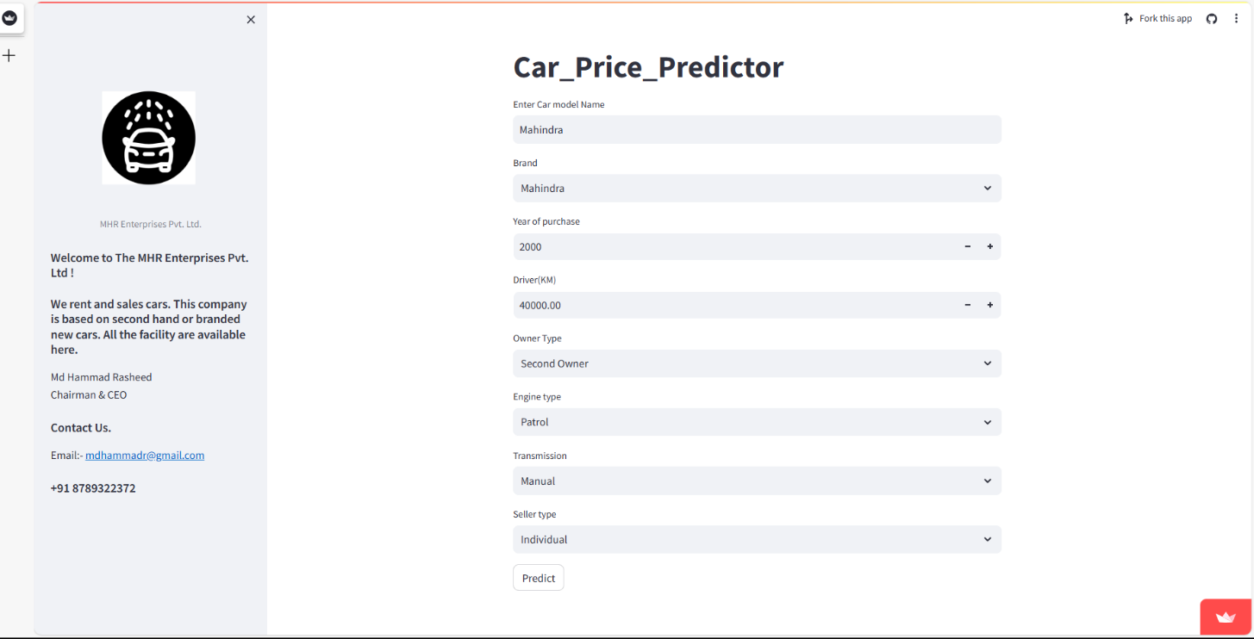
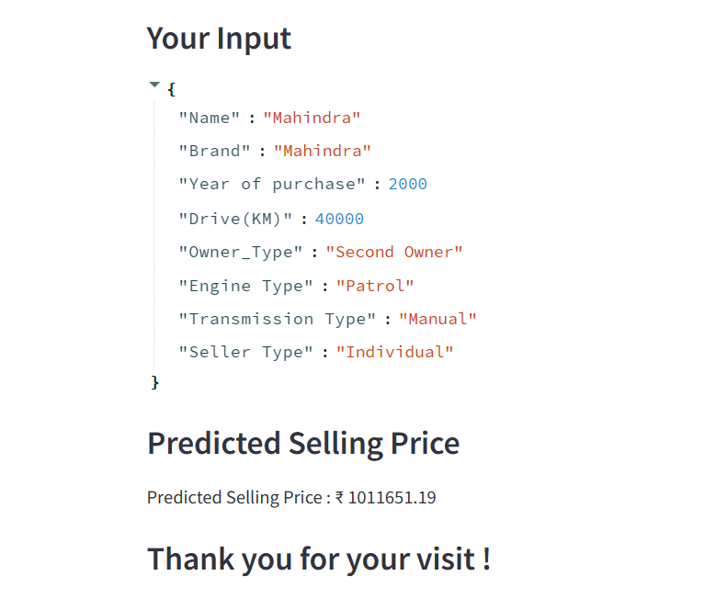
Car Price Predictor Interface in Streamlit Web App
19

Slide 20
Learning Objective/Internship Objectives
Objective and Problem Statement:
The main aim of this project is to predict the price of used cars using the various Machine Learning (ML) models. This can enable the customers to make decisions based on different inputs or factors namely
Brand
Model
Year of Purchase
Driver
Owner Type
Engine
Transmission etc.
to name a few characteristic features required by the customer. The project Car Price Prediction deals with providing the solution to these problems. Through this project, we will get to know which of the factors are significant and tell us how they affect the car’s worth in the market.
20

Slide 21
Exploratory Data Analysis (EDA)
It is a process used to analyse and summarize datasets, identifying characteristics, patterns, and relationships in the data before applying machine learning techniques.
Methods and techniques of EDA
There are several techniques and methods for performing an EDA, such as scatter plots, histograms, box plots, and descriptive statistics. The choice of techniques depends on the nature of the data and the goal of the analysis.
Data visualization
Data visualization is a powerful tool for identifying trends and patterns in datasets. Charts such as lines, bars, scatter, and box plots facilitate the identification of relationships between variables, frequency distributions, and the presence of outliers.
Descriptive statistics
Descriptive statistics summarize important information about the data, such as mean, median, mode, range, variance, and standard deviation. These measures can help identify central tendencies, dispersion, and skewness in the data.
Trends and patterns
Recognizing trends and patterns in the data is crucial for building effective machine learning models. These patterns can reveal valuable information about the data and provide insights to enhance models and improve predictions.

Slide 22
Data preparation and cleaning
Identifying and handling missing values
Missing values are common in datasets and can negatively impact the effectiveness of machine learning models. It is essential to identify and handle these values, either by filling them with appropriate information or removing them.
Treating categorical and numerical data
Categorical and numerical data must be treated differently during data preparation. It is necessary to transform categorical data into numerical variables using techniques such as one-hot encoding, while numerical data can be normalized or standardized.
Handling categorical data:
LabelEncoder() is an object from the sklearn.preprocessing library that converts categorical data into numerical labels.
A new DataFrame is created (data_label_encoded) as a copy of the preprocessed dataset.
The categorical column is transformed into numerical labels using the fit_transform method, and the result is saved in the new DataFrame. b. One-hot encoding:
OneHotEncoder() is an object from the sklearn.preprocessing library that creates new binary columns for each category in the original categorical column.
pd.get_dummies() is a pandas function that performs one-hot encoding on the specified columns.
The appropriate method for handling categorical data is chosen based on the specific dataset, and the result is saved as data_with_categorical_handled. In this example, one-hot encoding is used.

Slide 23
Handling numerical data:
a. Standard scaling:
StandardScaler() is an object from the sklearn.preprocessing library that standardizes numerical data by transforming it to have a mean of 0 and a standard deviation of 1.
A new DataFrame is created (data_standard_scaled) as a copy of the dataset with categorical data handled.
The numerical column is standardized using the fit_transform method, and the result is saved in the new DataFrame.
b. Min-max scaling:
MinMaxScaler() is an object from the sklearn.preprocessing library that scales numerical data to a specific range (default is [0, 1]).
A new DataFrame is created (data_min_max_scaled) as a copy of the dataset with categorical data handled.
The numerical column is scaled using the fit_transform method, and the result is saved in the new DataFrame.
The appropriate method for handling numerical data is chosen based on the specific dataset, and the result is saved as data_with_numerical_handled. In this example, standard scaling is used.
Final preprocessed dataset:
The final preprocessed dataset, data_final_preprocessed, is created by assigning the DataFrame with both categorical and numerical data handled. In this example, it is the DataFrame with one-hot encoding and standard scaling applied.
Note:
We already discussed in previous pages with proper code (See the Page 8-18).

Slide 24
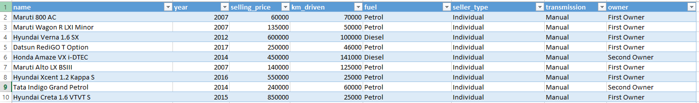
Motivation
Deciding whether a used car is worth the posted price when you see listings online can be difficult. Several factors, including mileage, make, model, year, etc. can influence the actual worth of a car. From the perspective of a seller, it is also a dilemma to price a used car appropriately[2-3]. Based on existing data, the aim is to use machine learning algorithms to develop models for predicting used car prices.
Dataset
For this project, we are using the dataset on used car sales from all over the United States, available on Kaggle [1]. The features available in this dataset are Mileage, VIN, Make, Model, Year, State and City.
Dataset Preview
21

Slide 25
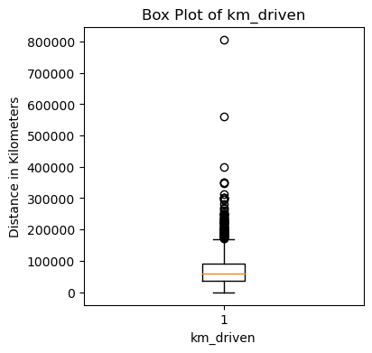
Plotting the box plot for Km_driven column of dataframe:
Box plots provide a quick visual summary of the variability of values in a dataset. They show the median, upper and lower quartiles, minimum and maximum values, and any outliers in the dataset. Outliers can reveal mistakes or unusual occurrences in data.
23

Slide 26
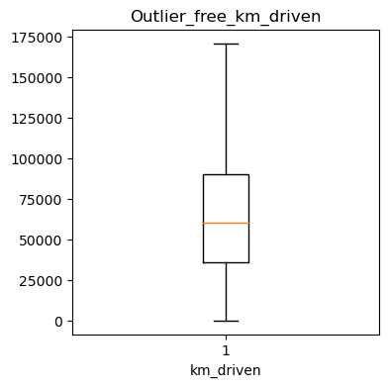
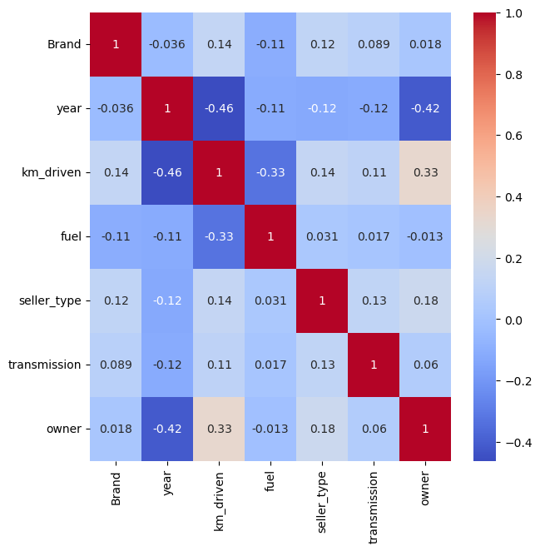
Removing outliers from Km_driven columns and Plotting box plot:
an outlier is an extremely high or extremely low data point relative to the nearest data point and the rest of the neighboring co-existing values in a data graph or dataset you're working with. Outliers are extreme values that stand out greatly from the overall pattern of values in a dataset or graph.
Plotting and Analyzing correlation table:
A correlation matrix is simply a table which displays the correlation coefficients for different variables. The matrix depicts the correlation between all the possible pairs of values in a table. It is a powerful tool to summarize a large dataset and to identify and visualize patterns in the given data.
24

Slide 27
Methodology
We utilized several classic and state-of-the-art methods, including ensemble learning techniques, with a 90% - 10% split for the training and test data. To reduce the time required for training, we used 500 thousand examples from our dataset. Linear Regression, Random Forest and Gradient Boost were our baseline methods. For most of the model implementations, the open-source Scikit-Learn package [7] was used.
Linear Regression Model
Linear Regression was chosen as the first model due to its simplicity and comparatively small training time. The features, without any feature mapping, were used directly as the feature vectors. No regularization was used since the results clearly showed low variance.
Random Forest Model
Random Forest is an ensemble learning based regression model. It uses a model called decision tree, specifically as the name suggests, multiple decision trees to generate the ensemble model which collectively produces a prediction. The benefit of this model is that the trees are produced in parallel and are relatively uncorrelated, thus producing good results as each tree is not prone to individual errors of other trees. This uncorrelated behavior is partly ensured by the use of Bootstrap Aggregation or bagging providing the randomness required to produce robust and uncorrelated trees. This model was hence chosen to account for the large number of features in the dataset and compare a bagging technique with the following gradient boosting methods.
Bagging Regression Model
Bagging, also known as bootstrap aggregation, is the ensemble learning method that is commonly used to reduce variance within a noisy dataset. In bagging, a random sample of data in a training set is selected with replacement—meaning that the individual data points can be chosen more than once.
Tree Regression Model
Tree-based regression models are known for their simplicity and efficiency when dealing with domains with large number of variables and cases. Regression trees are obtained using a fast divide and conquer greedy algorithm that recursively partitions the given training data into smaller subsets.
Polynomial Regression Model.
Polynomial regression is a kind of linear regression in which the relationship shared between the dependent and independent variables Y and X is modeled as the nth degree of the polynomial. This is done to look for the best way of drawing a line using data points.
25

Slide 28
SVM
What is SVM model in machine learning?
A support vector machine (SVM) is a type of supervised learning algorithm used in machine learning to solve classification and regression tasks; SVMs are particularly good at solving binary classification problems, which require classifying the elements of a data set into two groups.
26

Slide 29
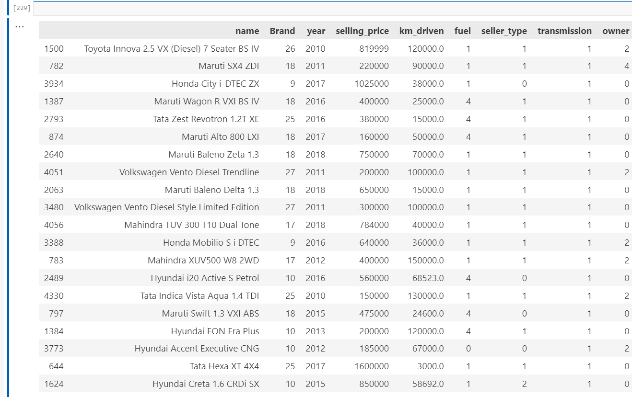
Creating 20 random point table for the further test
28

Slide 30
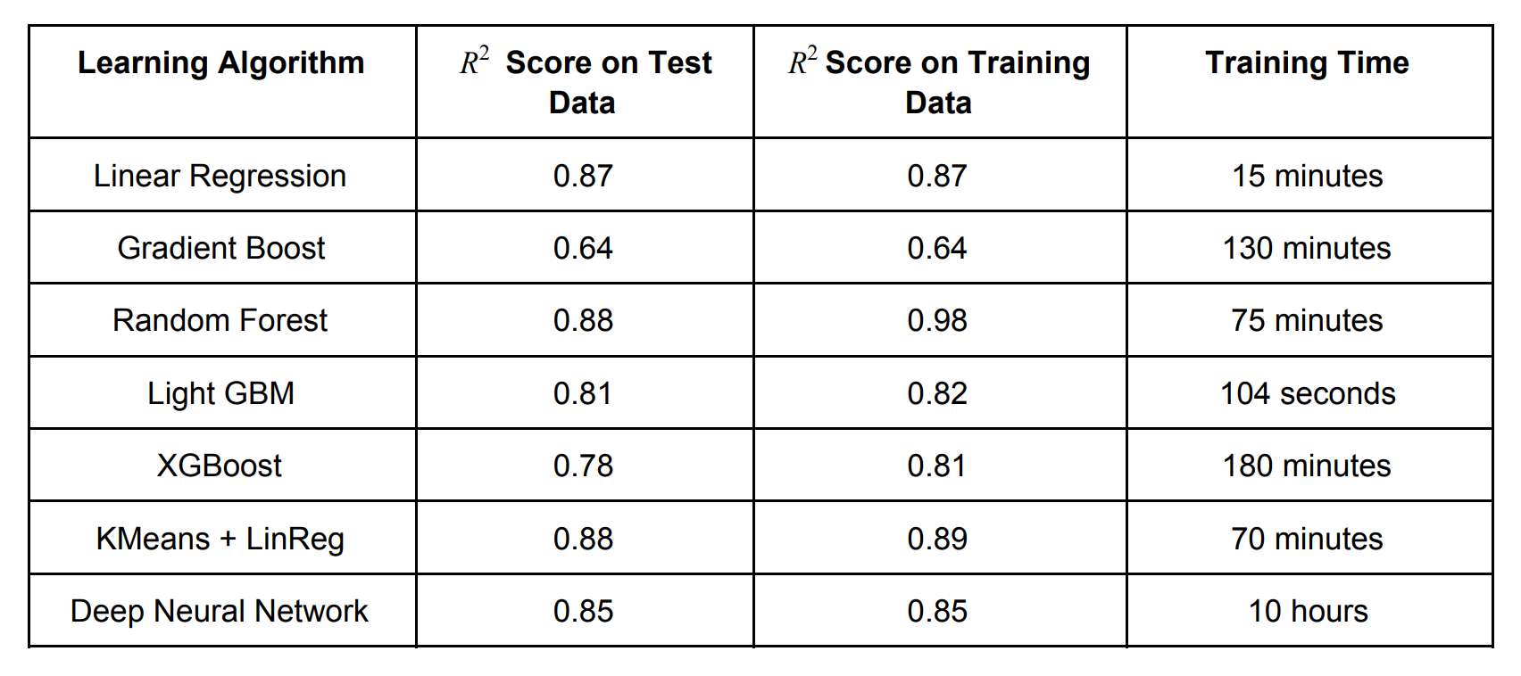
Results
The results of our tests were quantified in terms of the R² score of our predictions. score is a statistical R² measure of how close the data are to the fitted regression line.
Compared to Linear Regression, most Decision-Tree based methods did not perform comparably well.
This can be attributed to the apparent linearity of the dataset. We believe that It can also be attributed to the difficulty in tuning the hyperparameters for most gradient boost methods. The exception to this is the Random Forest method which marginally outperforms Linear Regression. However Random Forests tend to overfit the dataset due to the tendency of growing longer trees. This was worked upon by restricting the depth of trees to different values and it was observed that beyond limiting depth to 36 resulted in negligible improvement in prediction performance but progressively increased overfitting. As expected lightGBM performed marginally better than XGBoost but had a significantly faster training time. Building up from the relatively good performance of Linear Regression, the KMeans + Linear Regression Ensemble Learning Method (with K = 3) produced the best R score on test data without high variance as 2 it fits linear relationships categorically. The deep neural network was converging to local minima due to small batch-sizes.

Slide 31
Contributions
Both the team members contributed equally towards this project.
Link to project repository : Click Here
Link: (https://github.com/mhrofficial/Car_Price_Predictor.git)
29

Slide 32
References
https://www.kaggle.com/jpayne/852k-used-car-listings
N. Monburinon, P. Chertchom, T. Kaewkiriya, S. Rungpheung, S. Buya and P. Boonpou, "Prediction of prices for used car by using regression models," 2018 5th International Conference on Business and Industrial Research (ICBIR), Bangkok, 2018, pp. 115-119.
Listiani M. 2009. Support Vector Regression Analysis for Price Prediction in a Car Leasing Application. Master Thesis. Hamburg University of Technology
Chen, Tianqi, and Carlos Guestrin. "Xgboost: A scalable tree boosting system." Proceedings of the 22nd acm sigkdd international conference on knowledge discovery and data mining. ACM, 2016.
Ke, Guolin, et al. "Lightgbm: A highly efficient gradient boosting decision tree." Advances in Neural Information Processing Systems. 2017.
Fisher, Walter D. "On grouping for maximum homogeneity." Journal of the American statistical Association 53.284 (1958): 789-798.
https://scikit-learn.org/stable/modules/classes.html: Scikit-learn: Machine Learning in Python, Pedregosa et al., JMLR 12, pp. 2825-2830, 2011.
30

